Slide 1

The Impact of a Sedentary Lifestyle on Health: A Data-Driven Approach to Identifying Patterns and Solutions
Abdullahi Mohamed CST4390: Postgraduate Individual Project

Slide 2

Aims and Objectives
Aim
Analyse sedentary behaviour patterns across demographics and their impact on health.
Objectives
Find associations between sitting time and stress, sleep, and mood.
Evaluate occupational and demographic influences.
Develop data-driven recommendations.
Use of data tools explore to correlations.

Slide 3
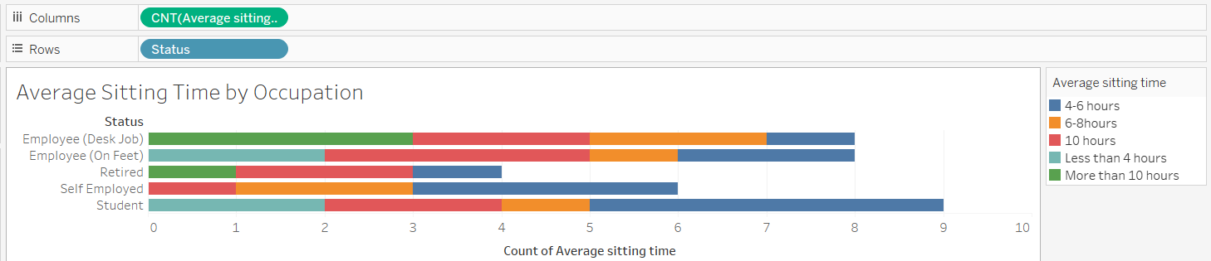
Rationale & Context
Sedentary behaviour is a growing public health concern.
COVID-19 increased remote work, reducing incidental movement.
WHO: 1.8 billion adults at risk from inactivity.
Timely need for interventions to reduce health risks.

Slide 4

Literature Review
Sedentary behaviour linked to cardiovascular disease and cancer (Salman, 2019).
Moderate exercise improves sleep quality (Wang, 2019).
Device use affects sleep and mood (Wang , 2019).
Body image and social media can impact mental health (Merino, 2024).

Slide 5
Methodology Overview
Data Sources
3 third-party datasets:
Tools
Excel: cleaning, descriptive analysis
SQL: relational queries
Tableau: visualisation dashboards

Slide 6
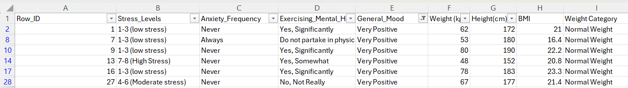
Key Findings
Positive mood correlates with higher activity and normal BMI.
10+ hour sitting common among desk workers.
Sleep quality improves with more frequent exercise.
Device usage over 6 hours linked to poorer sleep.

Slide 7
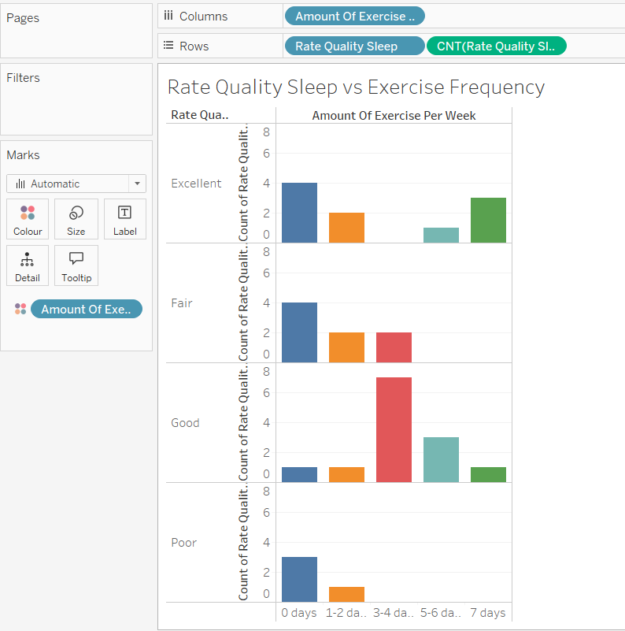
Analysis
Less than 2h device use = excellent sleep.
3+ breaks/day associated with lower anxiety.
Daily steps positively impact mood.
Desk workers highest average BMI.

Slide 8
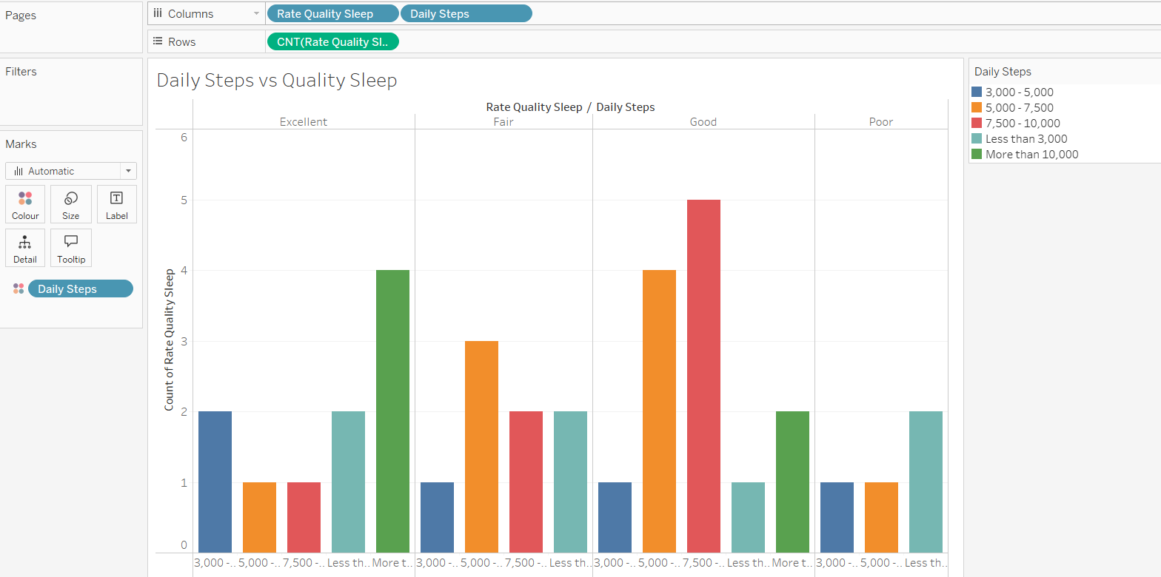
Further Insights
Visual patterns of sedentary time by occupation.
Sleep quality improves with 10,000 steps.
Device usage and sedentary behaviour closely linked.
BMI correlated with mood and exercise frequency.

Slide 9
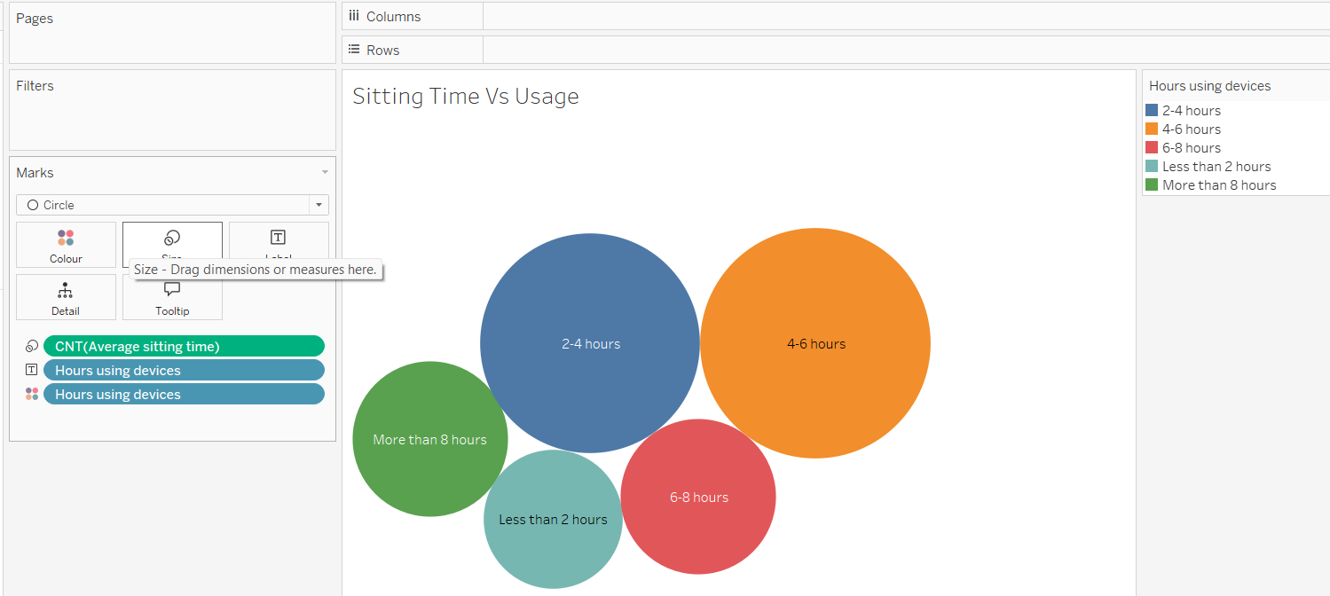
Recommendations
For Young Adults
Active learning spaces, screen time education.
For Working Adults
Mandatory movement breaks, active commuting incentives.
For Older Adults
Seated exercise programs, technology-assisted reminders.
Cross-Demographic
Family-based challenges, sleep-activity tracking

Slide 10
Limitations
Cross-sectional data limits causality.
Potential self-reporting bias.
Limited cultural context.
Small sample sizes in some demographics.

Slide 11
Future Work
Further studies to assess causal relationships.
Objective movement and sleep monitoring.
Larger and more diverse samples.
Development and testing of tailored interventions.

Slide 12
Reflection and Learning
Gained skills in data processing and visualisation.
Developed understanding of health behaviour analytics.
Learned to translate findings into actionable strategies.
Enhanced project planning and critical evaluation skills.

Slide 13

Questions

